Slide 1

UNIVERSITY REVIEWS
CAPSTONE PROJECT 1
MENTOR: HA THI NHU HANG

Slide 2
MEMBERS OF THE TEAM
01.
02.
03.
04.
NGUYEN VAN MINH TOI (team leader)
NGUYEN HUU THIEN
HUYNH THI QUY THUONG
HO XUAN SANG

Slide 3
CONTENTS
OVERVIEW
DEMO
CONCLUSION

Slide 4
INTRODUCTION
OVERVIEW
University Reviews is a website that provides useful information about universities in Vietnam to help students make the right decisions when choosing schools and majors and user can interact each other

Slide 5
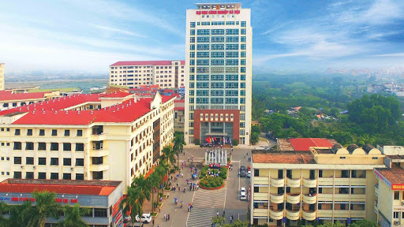

Lots of universities, students
Reviews of students about the course
WHY?

Slide 6
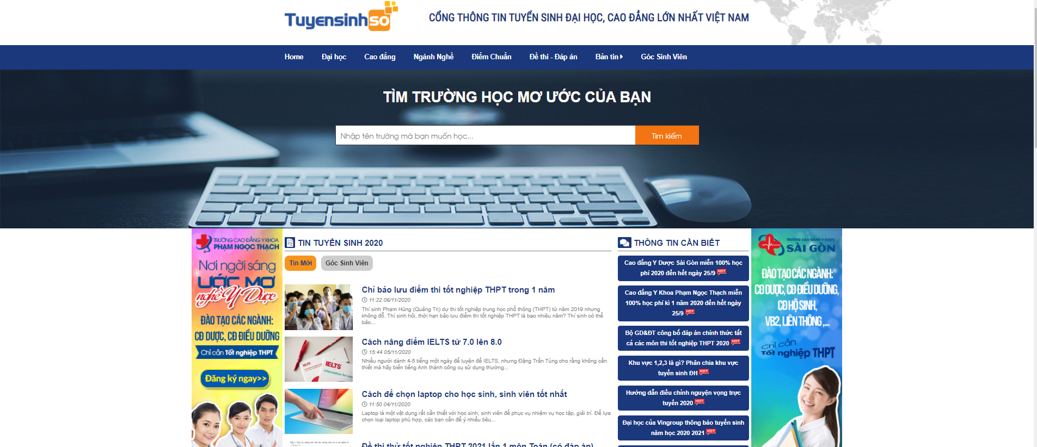
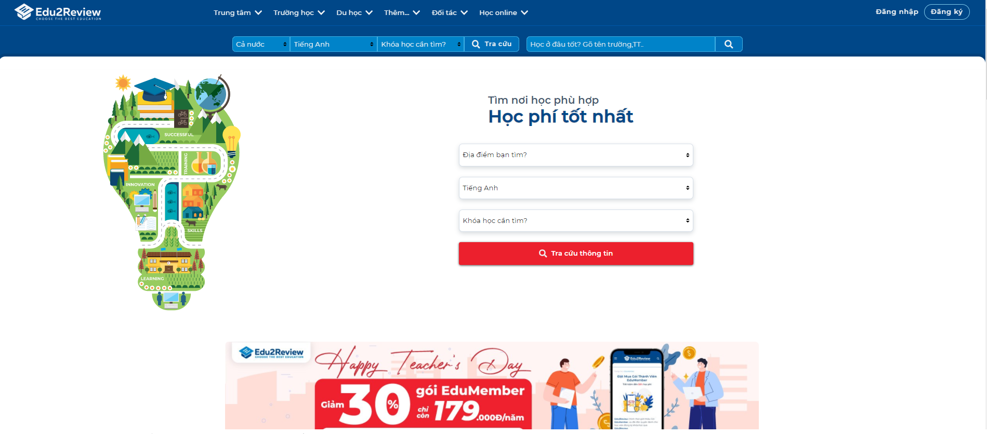
tuyensinhso
edu2review

Slide 7
Who?
admin
university
user
Manage and control all website content
Fill their information university like their major, their infrastructure …
watch and interact about the universities they are interested

Slide 8
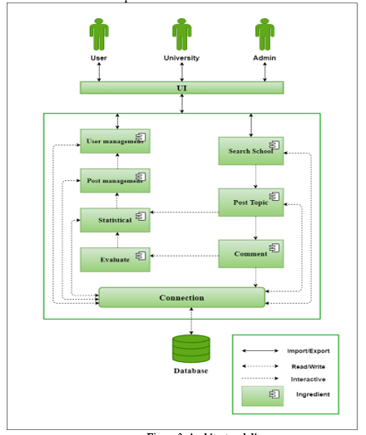
C & C view
Project Architecture

Slide 9
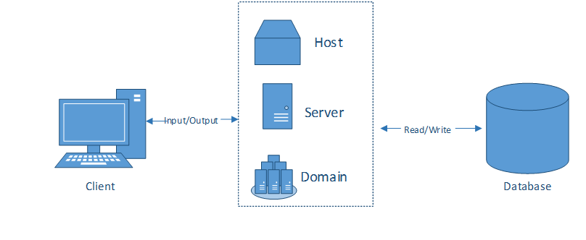
Allocation view
Project Architecture

Slide 10
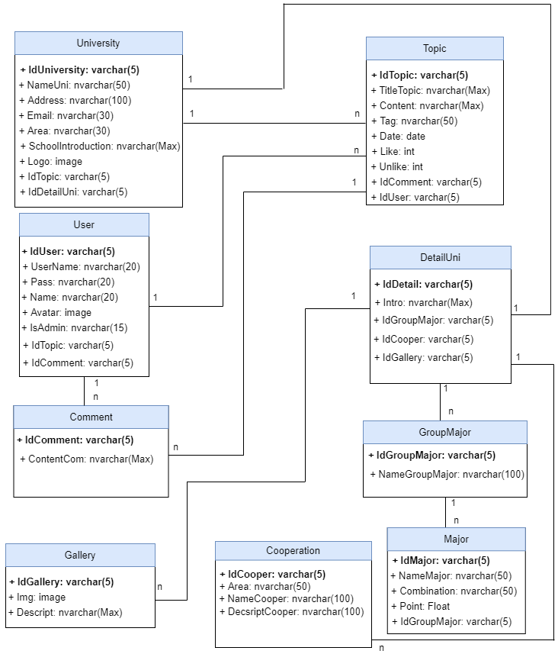
RELATIONSHIP DATABASE

Slide 11
Sprint 1 burndown chart

Slide 12
Sprint 2 burndown chart

Slide 13
Sprint 3 burndown chart

Slide 14
Sprint 4 burndown chart

Slide 15
develop tool
HTML/ CSS/ JavaSCRIPT
nodejs
REACT JS/ material ui
Keystone js
mongodb
Github/ trello

Slide 16
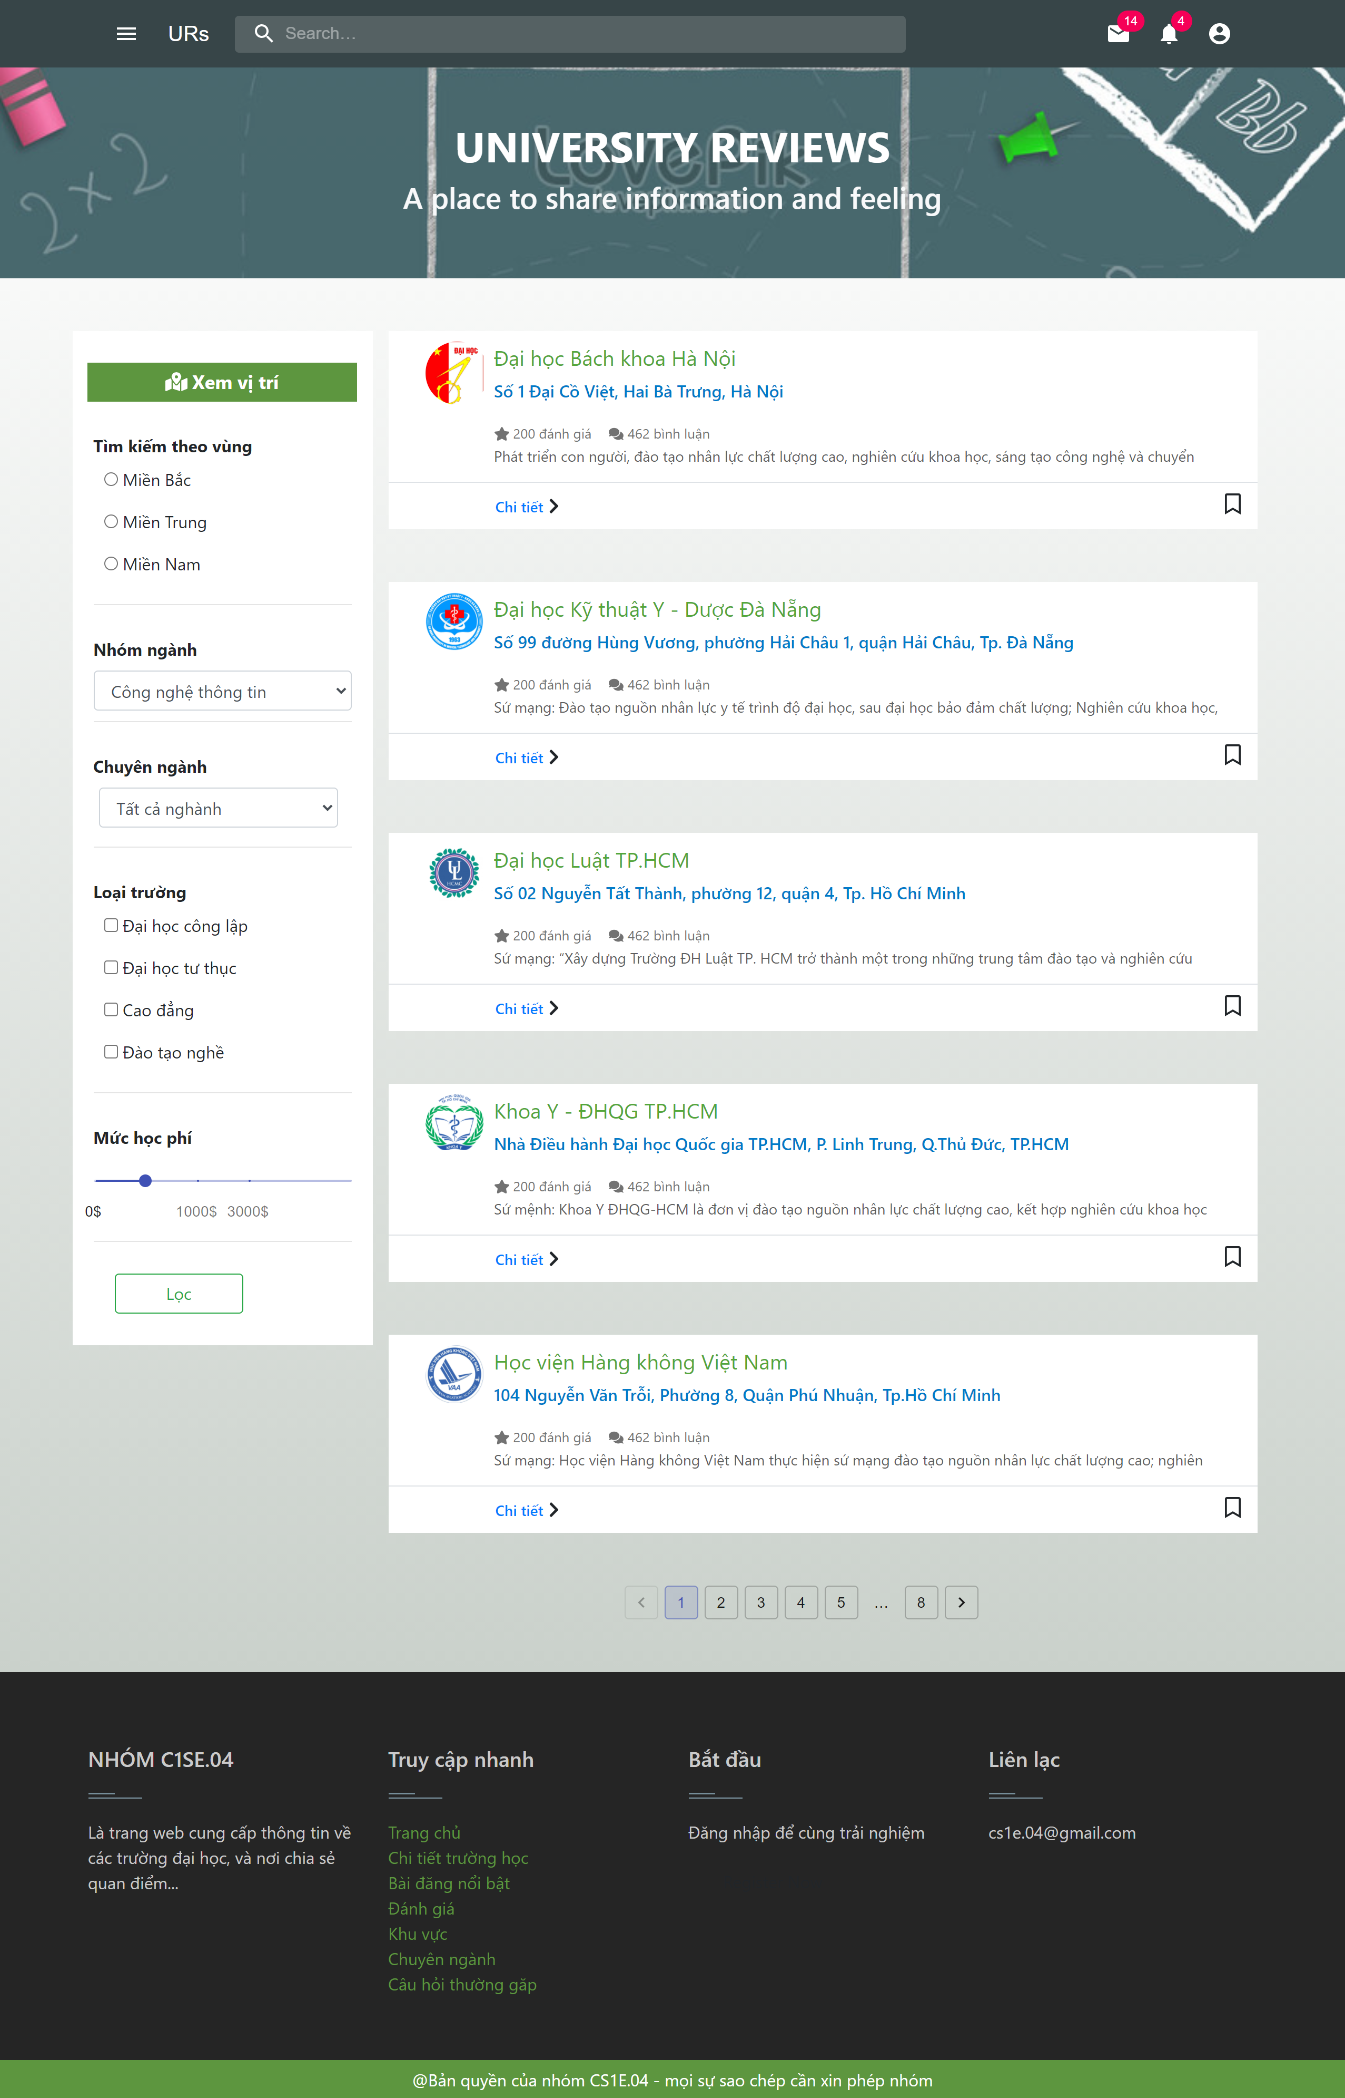
demo

Slide 17
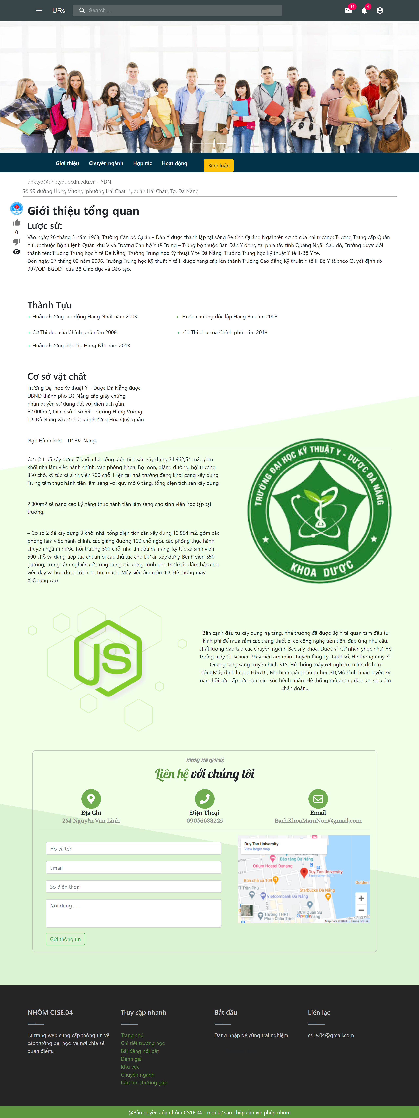
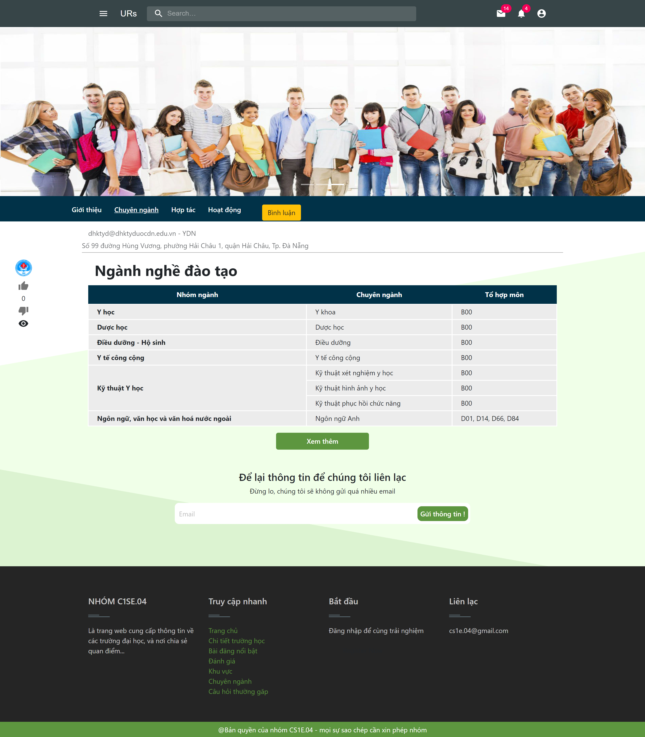
demo

Slide 18
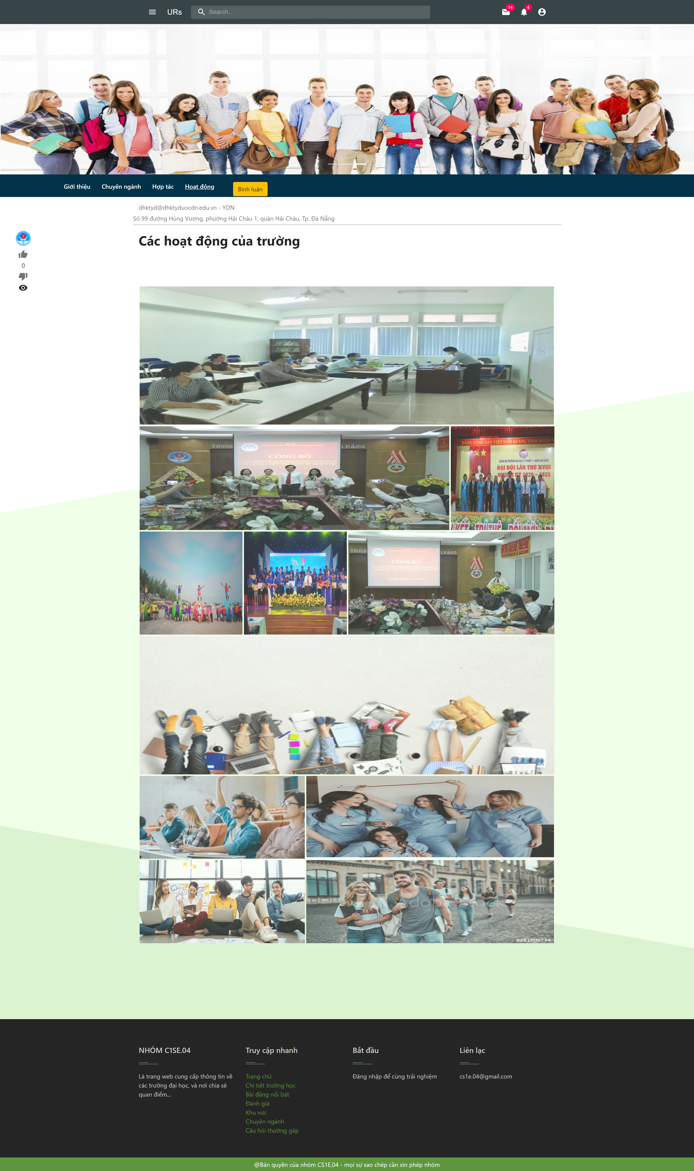
demo

Slide 19
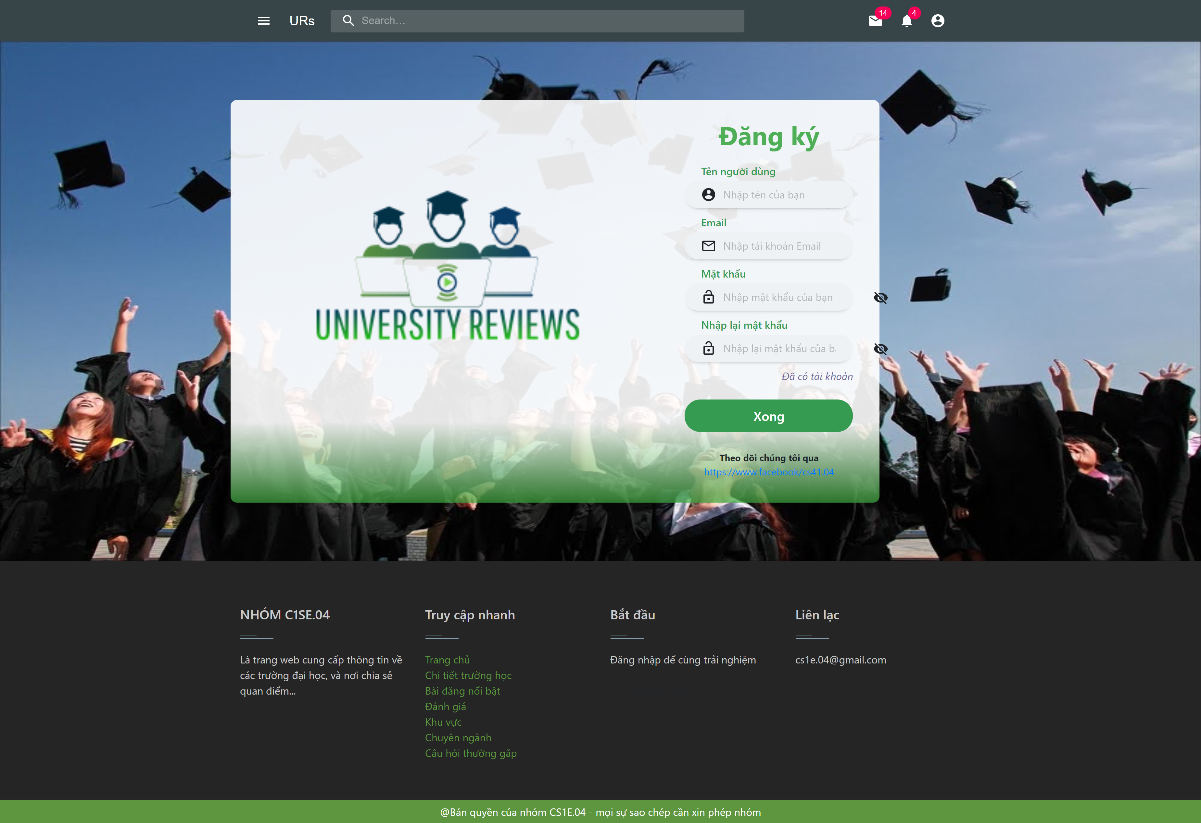
demo

Slide 20
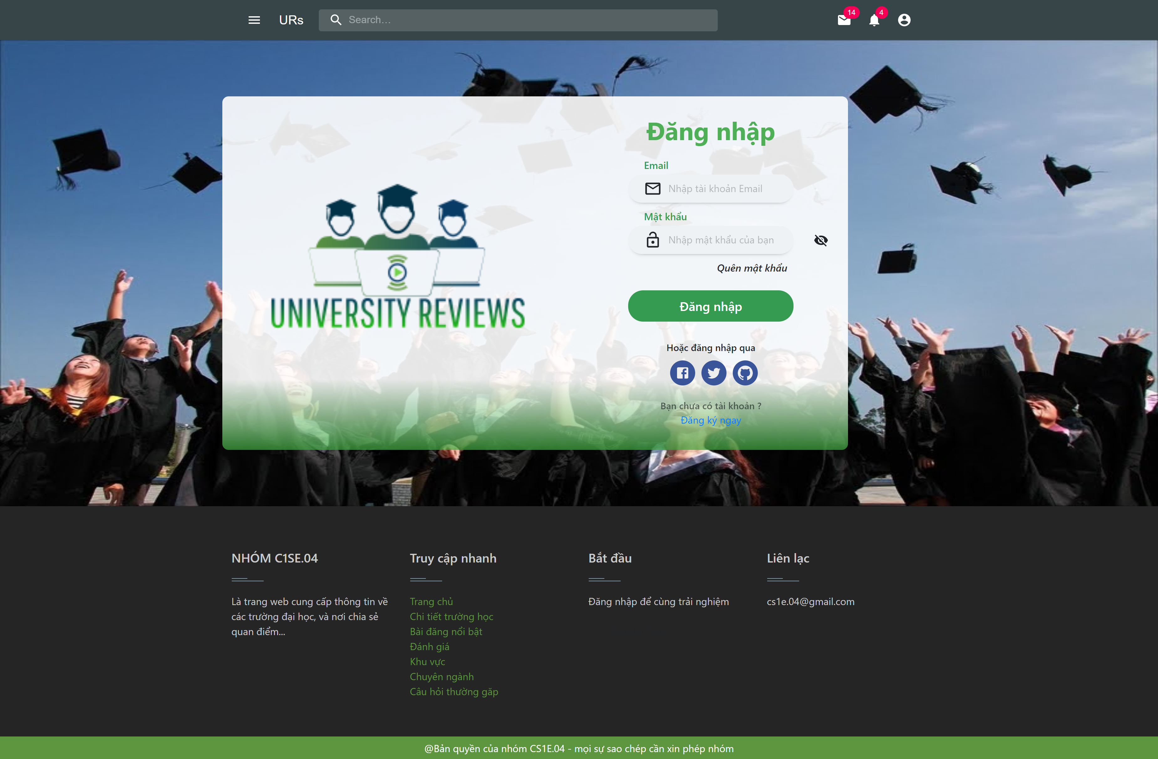
demo

Slide 21
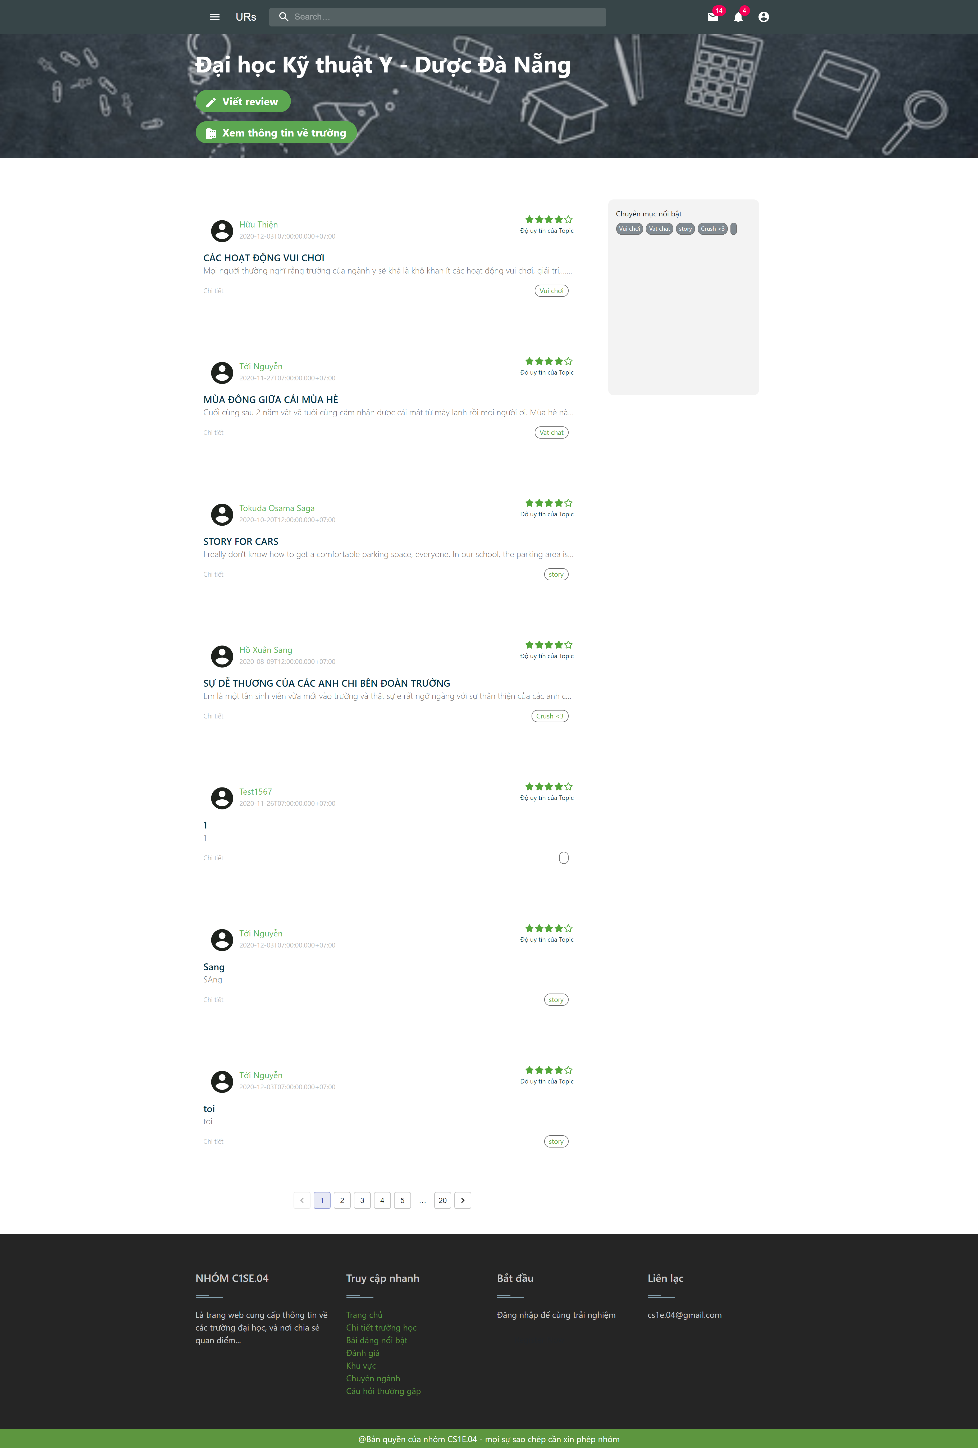
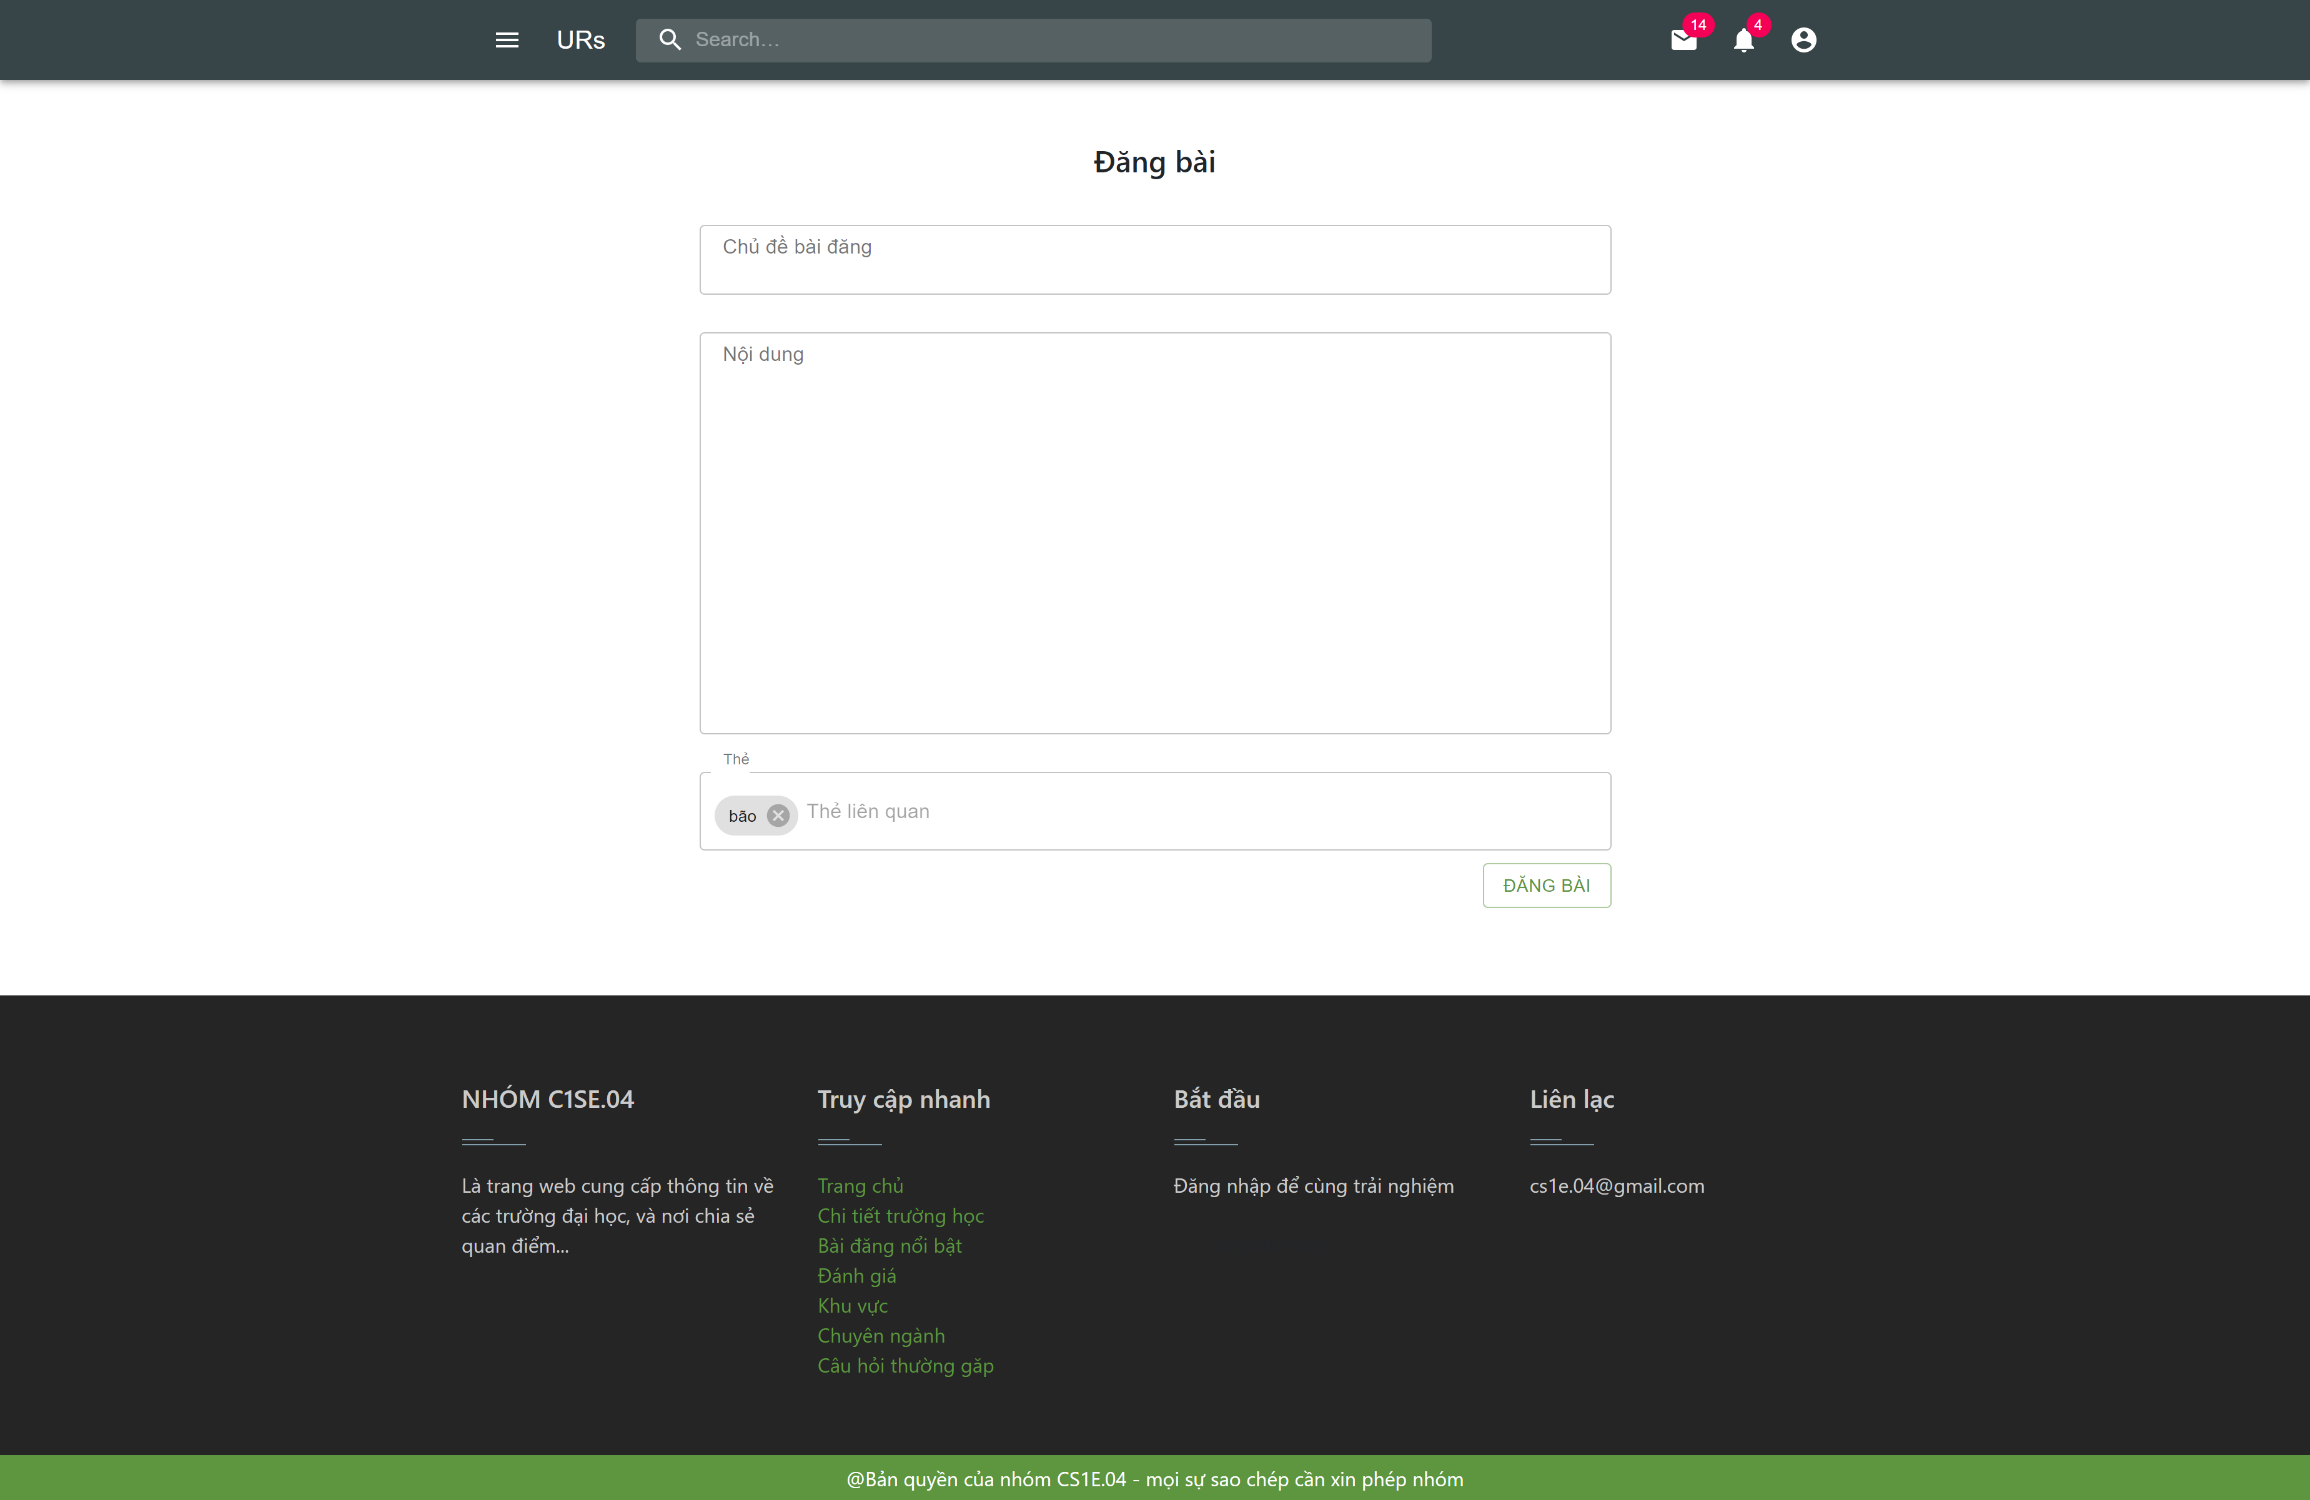
demo

Slide 22
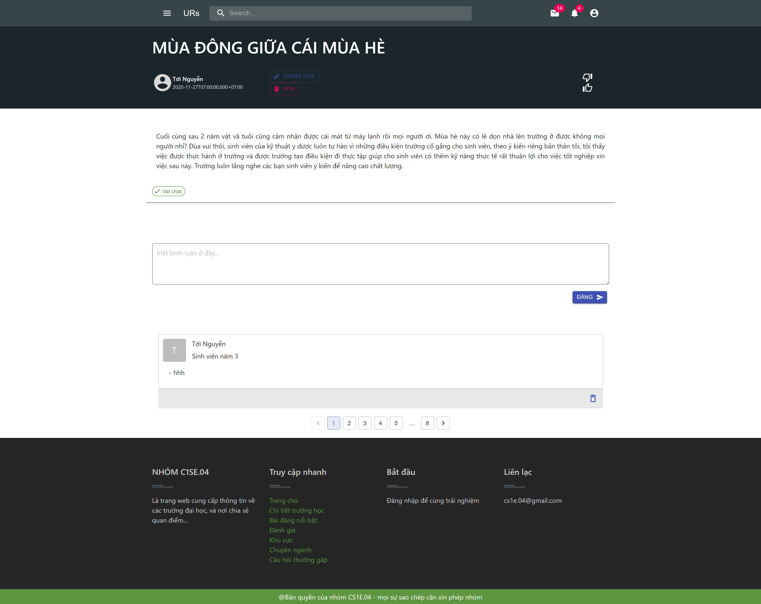
demo

Slide 23
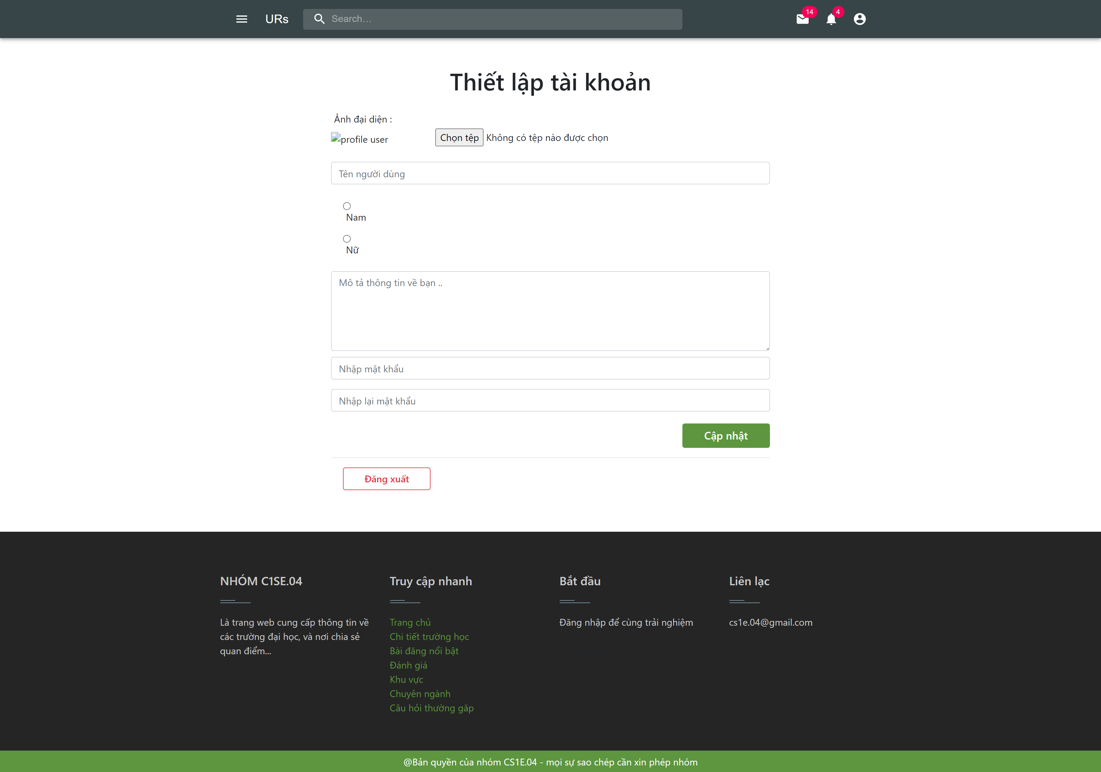
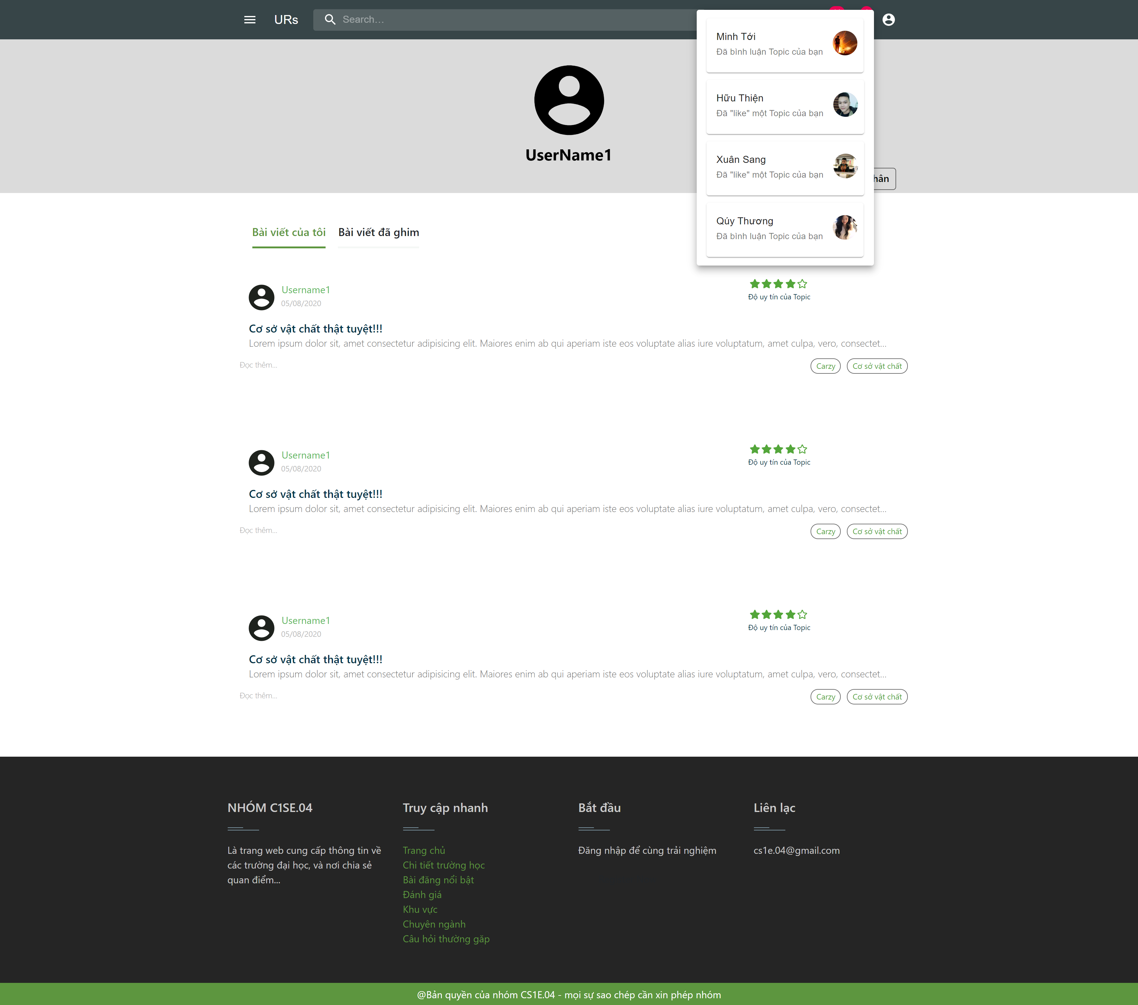
demo

Slide 24



CONCLUISION
90% complete
Learning
difficult
Insufficient time and resources
New technology
Improve process
Unify ideas and manage time

Slide 25
THANKS!
Does anyone have any questions?

Slide 26
Dự phòng

Slide 27
Dự phòng

Slide 28
Allocation view
WORK PROGRESS

Slide 29

Process
Sprint 1
Sprint 2
Sprint 3
Sprint 4
Finished
Finished
Processing
Unfinished

Slide 30
DOCUMENTS
PROPOSAL
SPRINT BACKLOG
PROJECT PLAN
USER INTERFACE DESIGN
USER STORY
DATABASE DESIGN

Slide 31

Problems encountered
Unfinished achitecture documentation
Have not written test documents

Slide 32

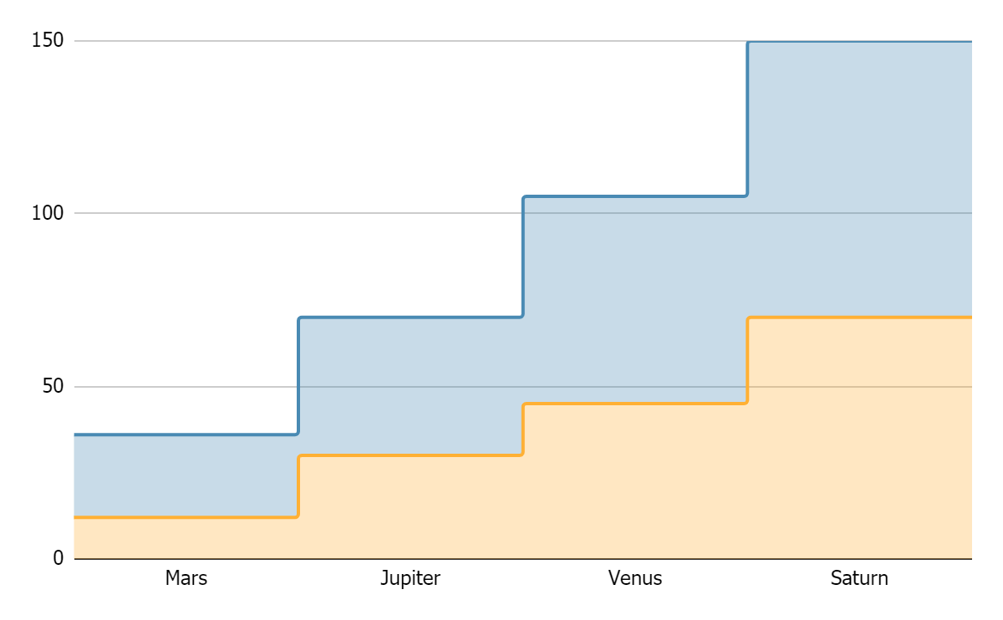
TOPIC DATA
Mercury
Pluto
If you want to modify this graph, click on it, follow the link, change the data and replace it

Slide 33




RECOMMENDATIONS
MARS
VENUS
JUPITER
SATURN
Despite being red, Mars is actually a cold place
Venus has a beautiful
name, but it’s hot
It’s the biggest planet in our Solar System
Saturn is the ringed one
and a gas giant

Slide 34




PRACTICAL EXERCISE
Mercury is the closest planet to the Sun and the smallest one in the Solar System—it’s only a bit larger than our Moon. The planet’s name has nothing to do with the liquid metal, since it was named after the Roman messenger god, Mercury

Slide 35
ALTERNATIVE RESOURCES

Slide 36
RESOURCES
Did you like the resources on this template? Get them for free at our other websites.
VECTORS
People working at the office flat design
Collection of young men and women reading
Set of young men and women reading
Flat business landing page template
People at the office
People at the office
Flat world book day banners
Office workers sitting at desks
PHOTOS
Close-up of woman doing her work
If you want to apply the same filter as the picture included in the template, follow these instructions:
IN GOOGLE SLIDES:
Insert the picture in the slide.
Go to Format options and recolor the picture by applying a black & white filter.
Create a shape with the same size as the picture and fill it with the #ffad802f color.
Place the shape on top of the picture. You can adjust the transparency as you see fit.

